Slide 1
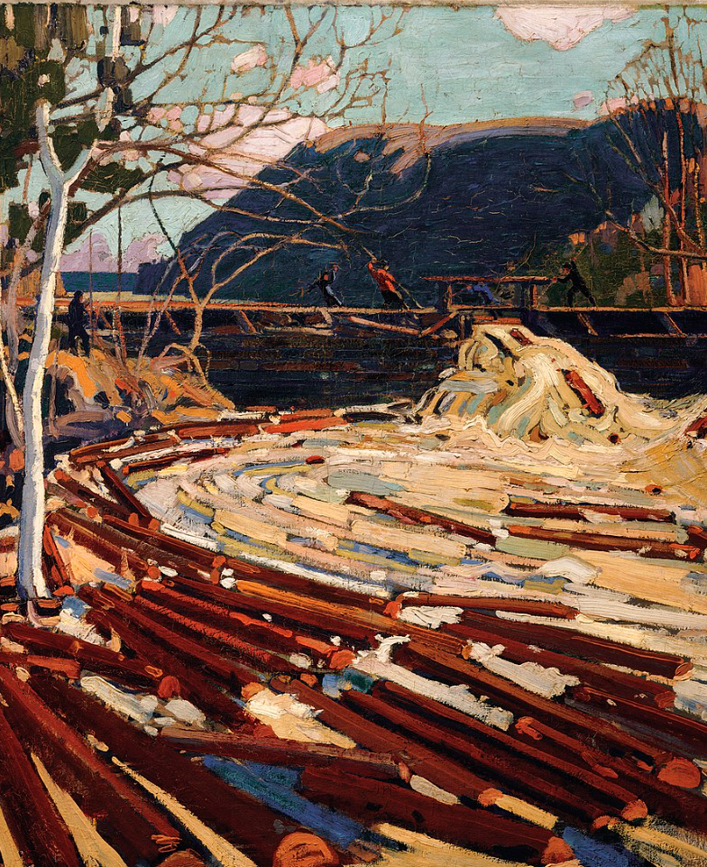

Why, who & levels of S&E governance
IL “Sustainability & Environmental Management” SS 25
Kami Höferl
(Thomson, 1916, PD)

Slide 2
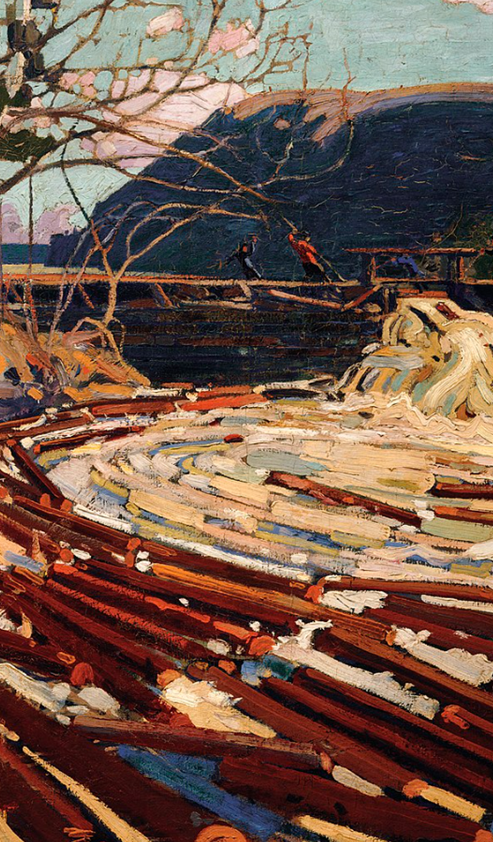
Overview
Let‘s goooo …
Do we still need S&E management?
Who is in charge?
From S&E management to S&E governance
(Thomson, 1916, PD)
(Escher, 1961)

Slide 3
So …

Slide 4
So: Same-Same, but different … yeah, we know …
Aspect | Sustainability Management | Environmental Management
Definition | Strategic integration of environmental, social & economic considerations into decision-making 👉 long-term resilience | Managing environmental impacts & compliance with regulations 👉 minimize ecological harm
Main Goal | Long-term sustainable development balancing economic growth, social well-being & ecological integrity | Prevent, mitigate, and remediate environmental harm from human activities
Key Focus Areas | Environmental, Social, and Governance (ESG), Circular Economy, Corporate Social Responsibility (CSR), Stakeholder Engagement | Pollution control, waste management, biodiversity conservation, regulatory compliance

Slide 5

So …
👉 give me the tools & we manage it!

Slide 6

So …

Slide 7
Why should we do this?

Slide 8
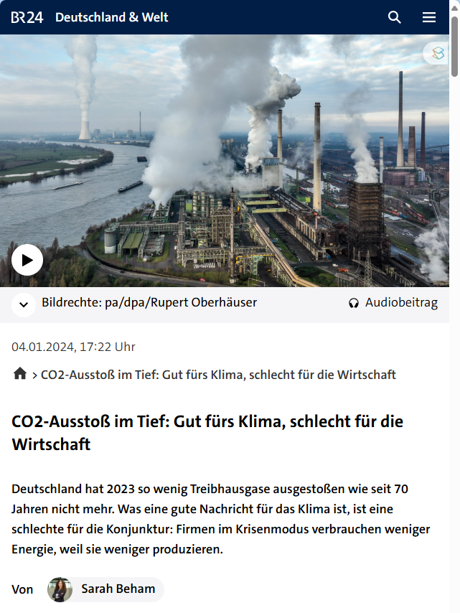
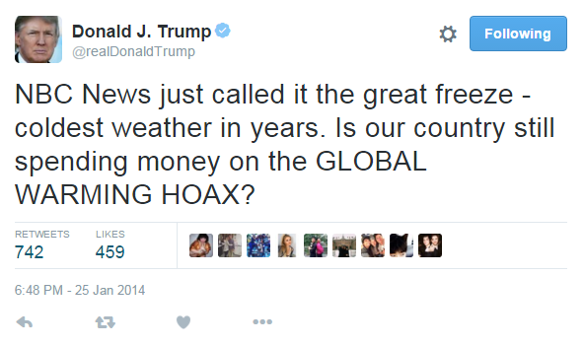
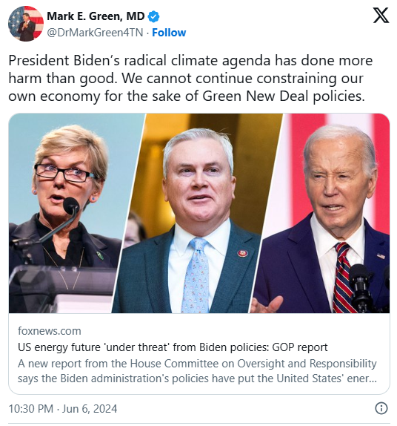
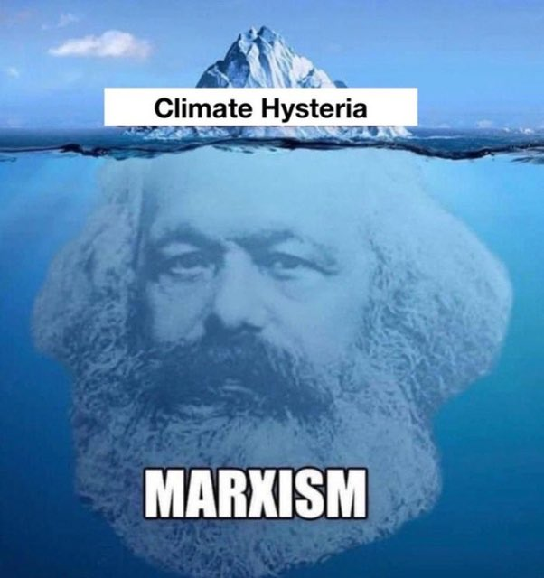
Isn’t Sustainability & Environmental Management bad for Business?

Slide 9
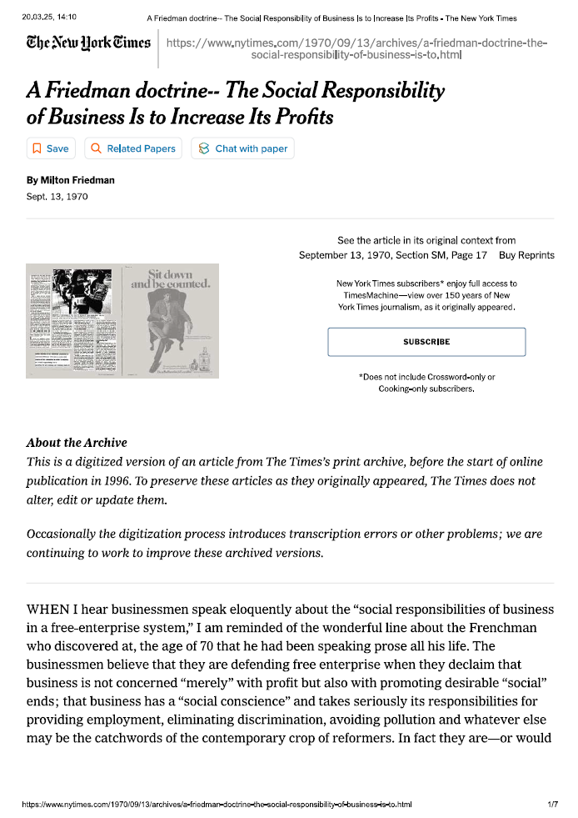
Isn’t Sustainability & Environmental Management bad for Business?
https://www.nytimes.com/1970/09/13/ archives/a-friedman-doctrine-the-social-responsibility-of-business-is-to.html

Slide 10
Friedman’s (1970) Perspective: Focus of Profits as Social Responsibility
Primary Responsibility to Shareholders
Corporate executives = agents of shareholders, obligated to prioritise their interests 👉primarily profit maximization
Role of Business vs. Government
Addressing social issues = domain of government and individuals, not businesses
👉 executives allocating resources to social causes without shareholder approval = imposing taxes and deciding how those taxes are spent
Adherence to Legal & Ethical Standards
While pursuing profits, businesses must operate within the "rules of the game“ = open and free competition without deception or fraud

Slide 11
Critique to Friedman’s (1970) Perspective:
Neglect of Stakeholder Interests:
Prioritising shareholder profits 👉 neglecting responsibilities to other stakeholders
E.g. employees, customers & community
Short-Term Focus:
Emphasizing immediate profits 👉 underinvestment in long-term strategies
E.g. research, development & employee welfare
Ethical and Social Responsibilities
Businesses have moral obligations to address social and environmental issues, which profit maximization alone may not fulfill. ​
Risk of Ethical Misconduct
Focus on profits 👉 unethical behaviors
E.g .compromising product safety or engaging in deceptive practices

Slide 12
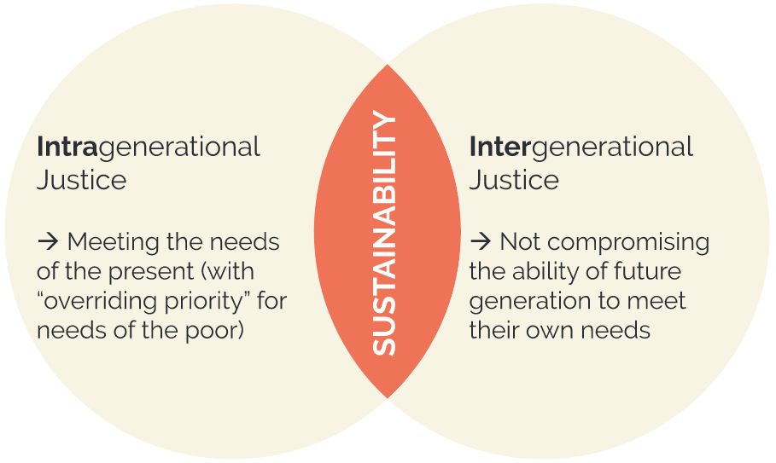
A. Do the Right Thing?
👉 Ethical obligation to do so:
Future generations should not suffer from the resource depletion & environmental degradation caused by current economic activities
Address inequalities within the present generation, ensuring fair access to resources & opportunities​
👉 “Do unto others as you would have them do unto you”

Slide 13
So …
👉 give me the tools & we manage it!

Slide 14
B. Corporate Responsibility beyond Freidman
Companies operate in societies 👉 need “license to operate”:

Slide 15
… License to Operate?
🤔

Slide 16
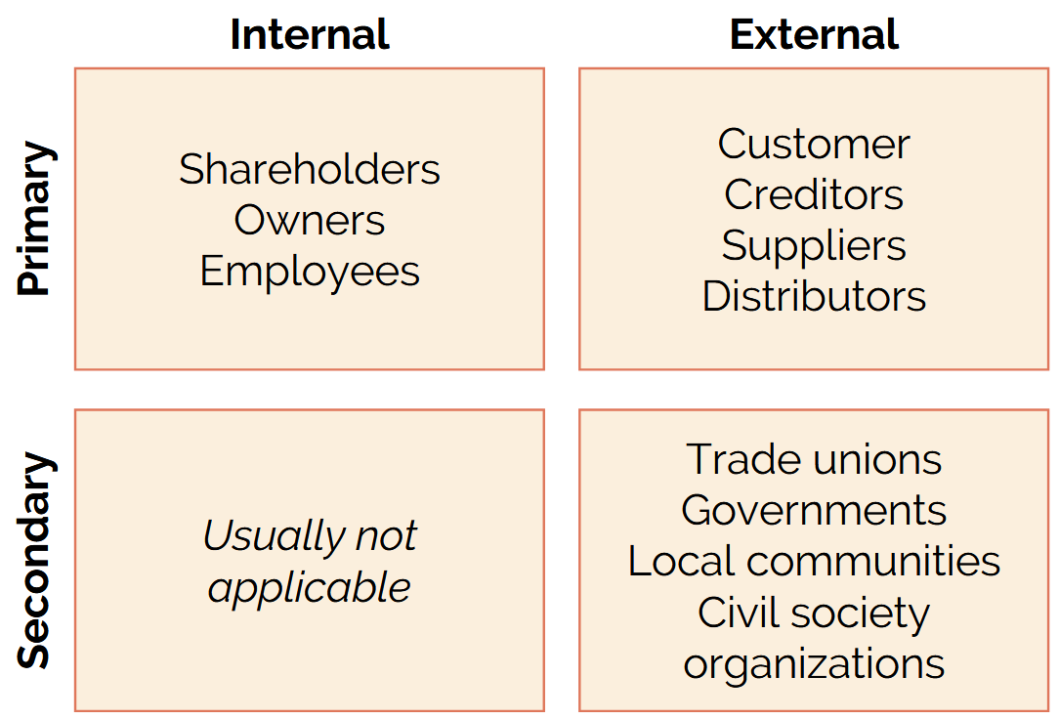
B. Corporate Responsibility beyond Friedman
companies operate in societies 👉 need “license to operate”:
ongoing acceptance or approval granted to an organization
by its stakeholders:
interested public
local communities
Governments
Regulators
to conduct its operation
👉 responsibilities beyond mere profit-seeking
Focus = primary, internal shareholders

Slide 17
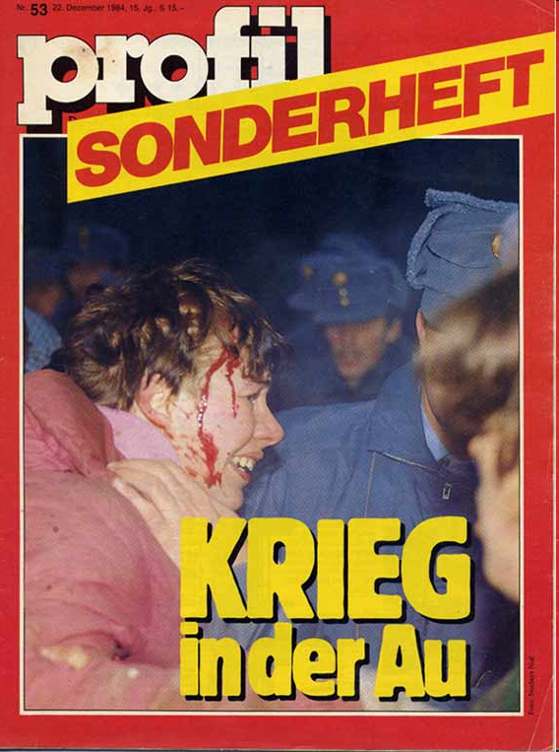
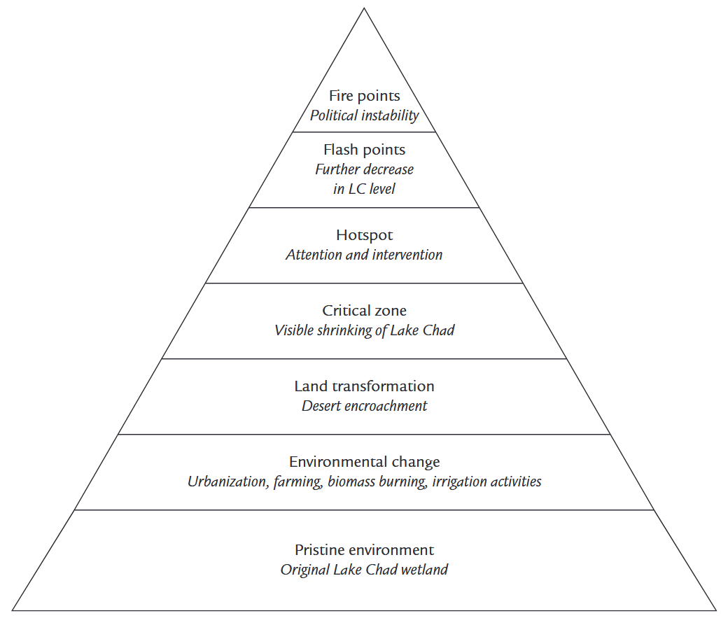
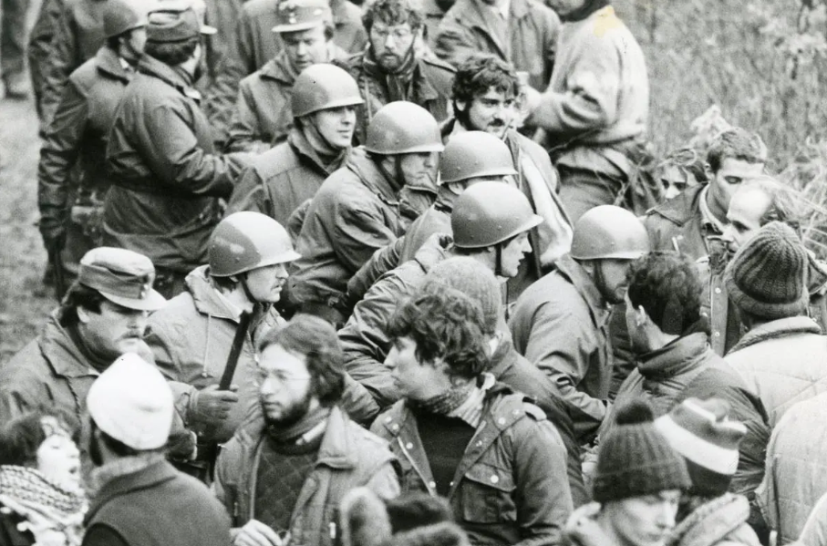
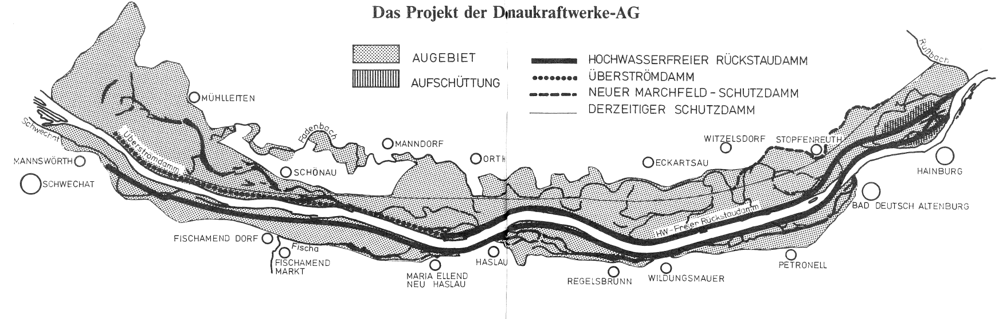
B. Corporate Responsibility beyond Friedman: Reality Check

Slide 18
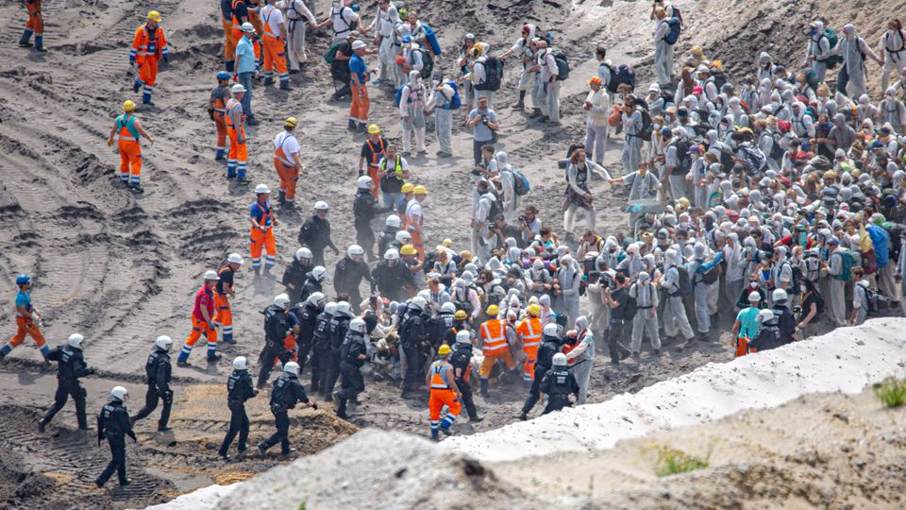
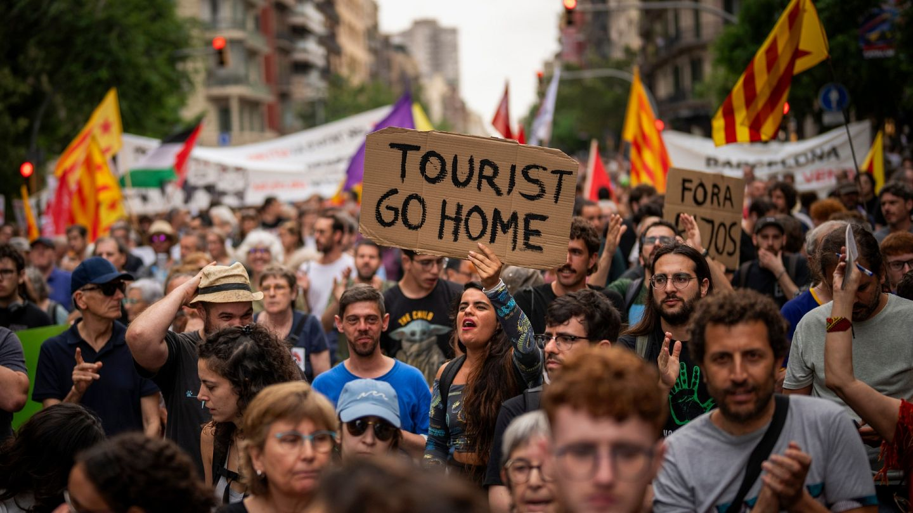
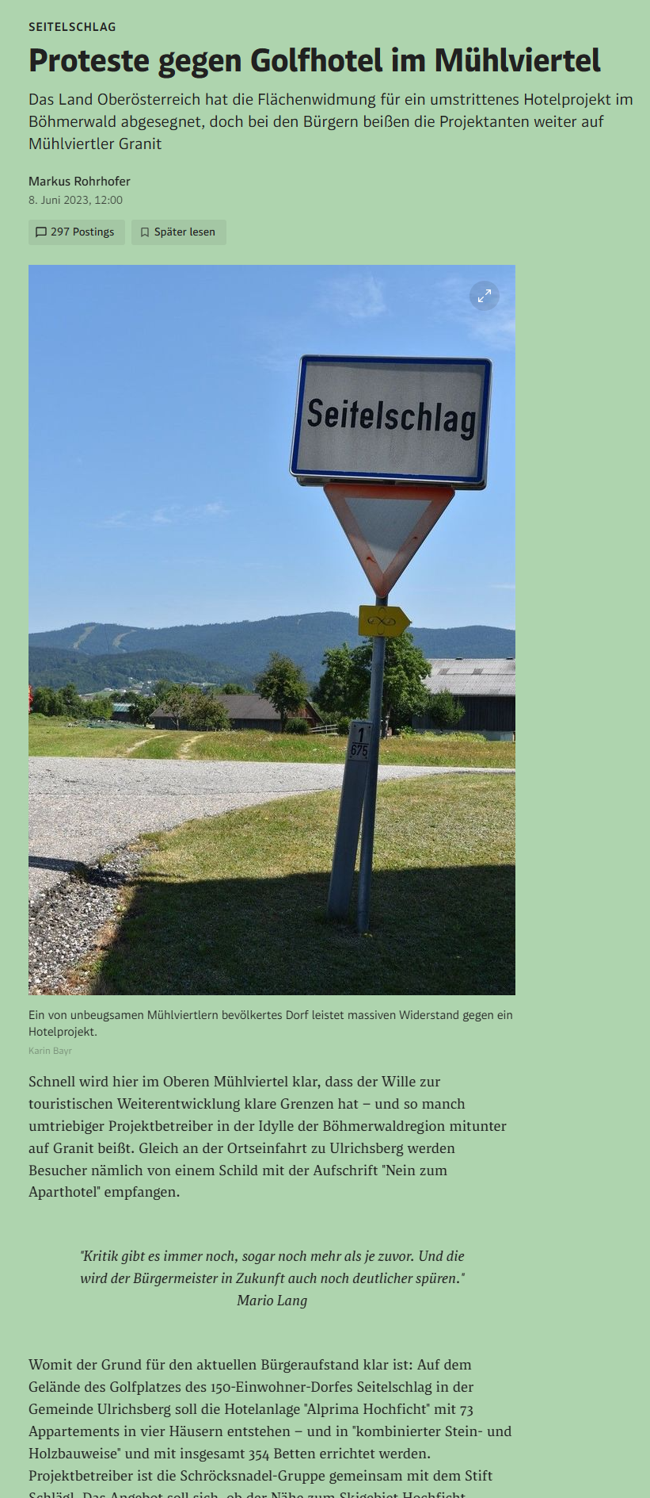
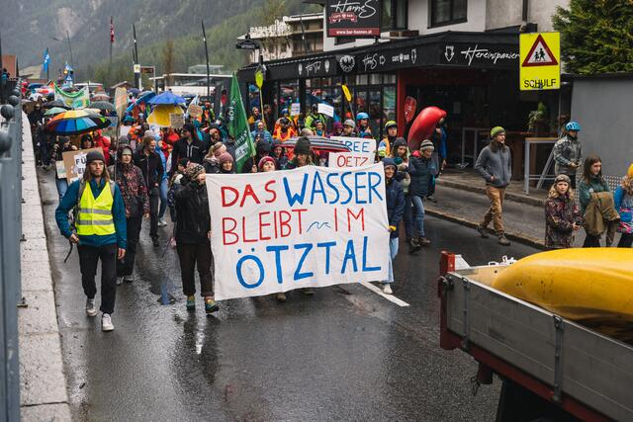
B. Corporate Responsibility beyond Freidman: Reality Check
Notes:
Coal digging in Lüzerath, Tagebau Garzweiler

Slide 19
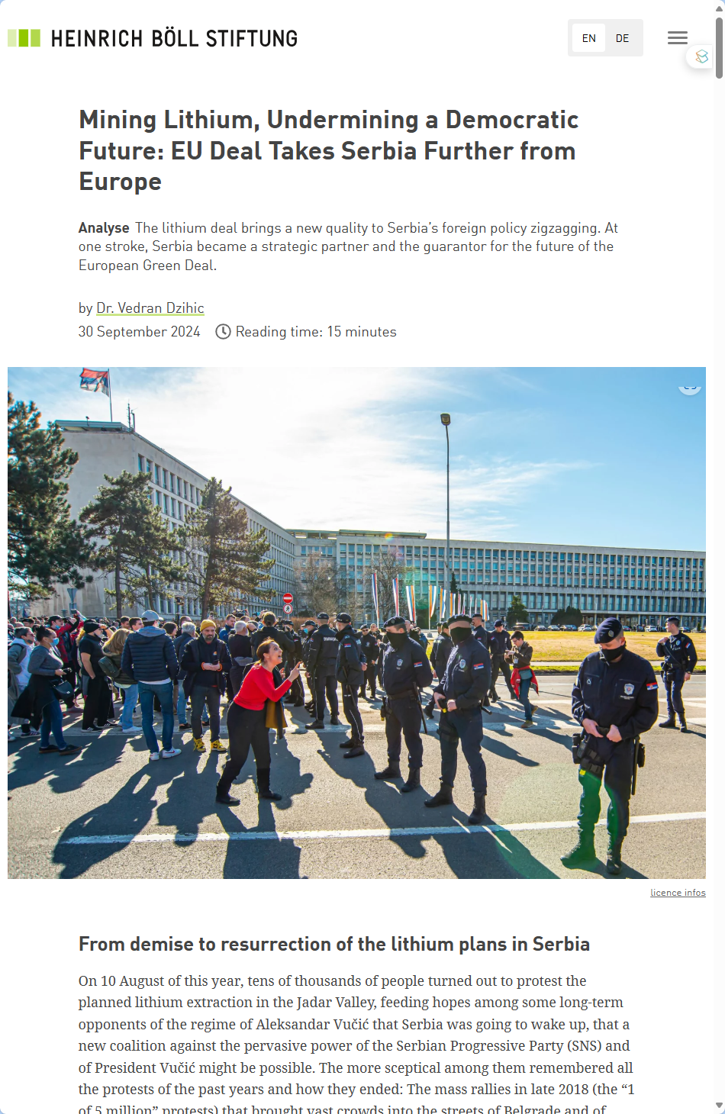
B. Corporate Responsibility beyond Freidman
companies operate in societies 👉 need “license to operate”
responsibilities beyond mere profit-seeking
align business practices aligned with societal well-being:
long-term viability
reducing risks
social unrest, environmental crises & regulatory backlash

Slide 20
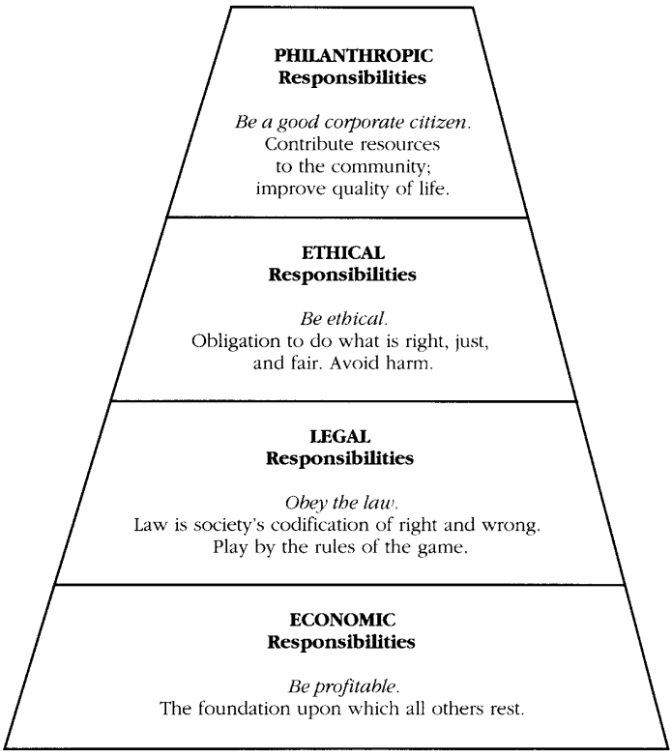
C. Beyond Legal Requirements: Corporate Social Responsibility
?
UN Universal Declaration of Human Rights:
👉 societal actors (also businesses) uphold human rights
Corporate responsibility = extends beyond legal compliance
include environmental and social issues
👉 Corporate Social Responsibility?

Slide 21
C. What is CSR?
Corporate Social Responsibility:
“CSR is the continuing commitment by business to contribute to economic development while improving the quality of life of the workforce, their families, and the local community and society at large.” (World Business Council for Sustainable Development, n.d.)
“CSR is the responsibility of an organisation for the impacts of its decisions and activities on society and the environment, through transparent and ethical behaviour.” (ISO 26000)

Slide 22
@ ethical behaviour:
Transparency and Accountability
Open communication and taking responsibility for decisions and impacts.
Fair Treatment of Stakeholders
Ensuring fairness, equity, and respect for employees, customers, and communities.
Environmental Responsibility
Reducing ecological impact and promoting sustainable practices.
Compliance with Laws and Standards
Adhering to local, national, and international regulations.
Integrity in Operations
Avoiding corruption, fraud, and unethical practices.
Commitment to Human Rights
Respecting dignity, diversity, and equality in all activities.
Long-Term Thinking
Balancing profitability with sustainable development for future generations.

Slide 23
C. Dimensions of CSR

Slide 24

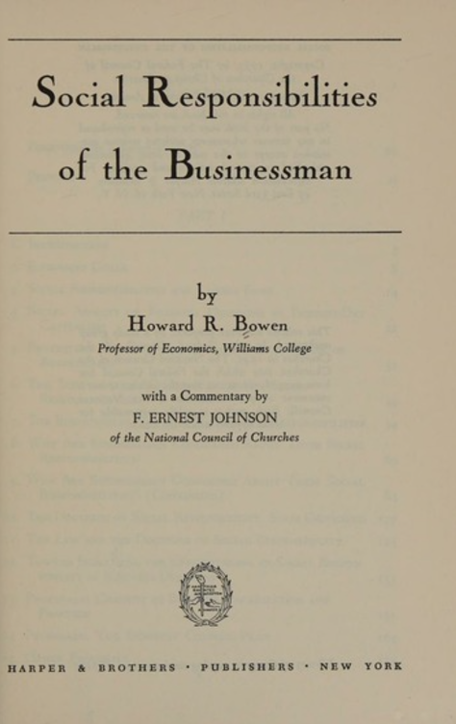
C. Was CSR always there?
Pre-20th Century Philanthropy Era:
charitable donations by wealthy industrialists
Mid-20th Century (1950s-1970s): CSR emerging
1953: Howard Bowen "Social Responsibilities of the Businessman“ CSR = duty to society
businesses balancing profit with social good
1980s-1990s: Stakeholder Theory
Freeman (1984): accountability to all stakeholders, not just shareholders
Notes:
Andrew Carnegie 1889: steel plants
* Donated ~ 10 Bio. $
Gilded age 👉 first moguls
universities, libraries, medical institutions, public parks, and more

Slide 25
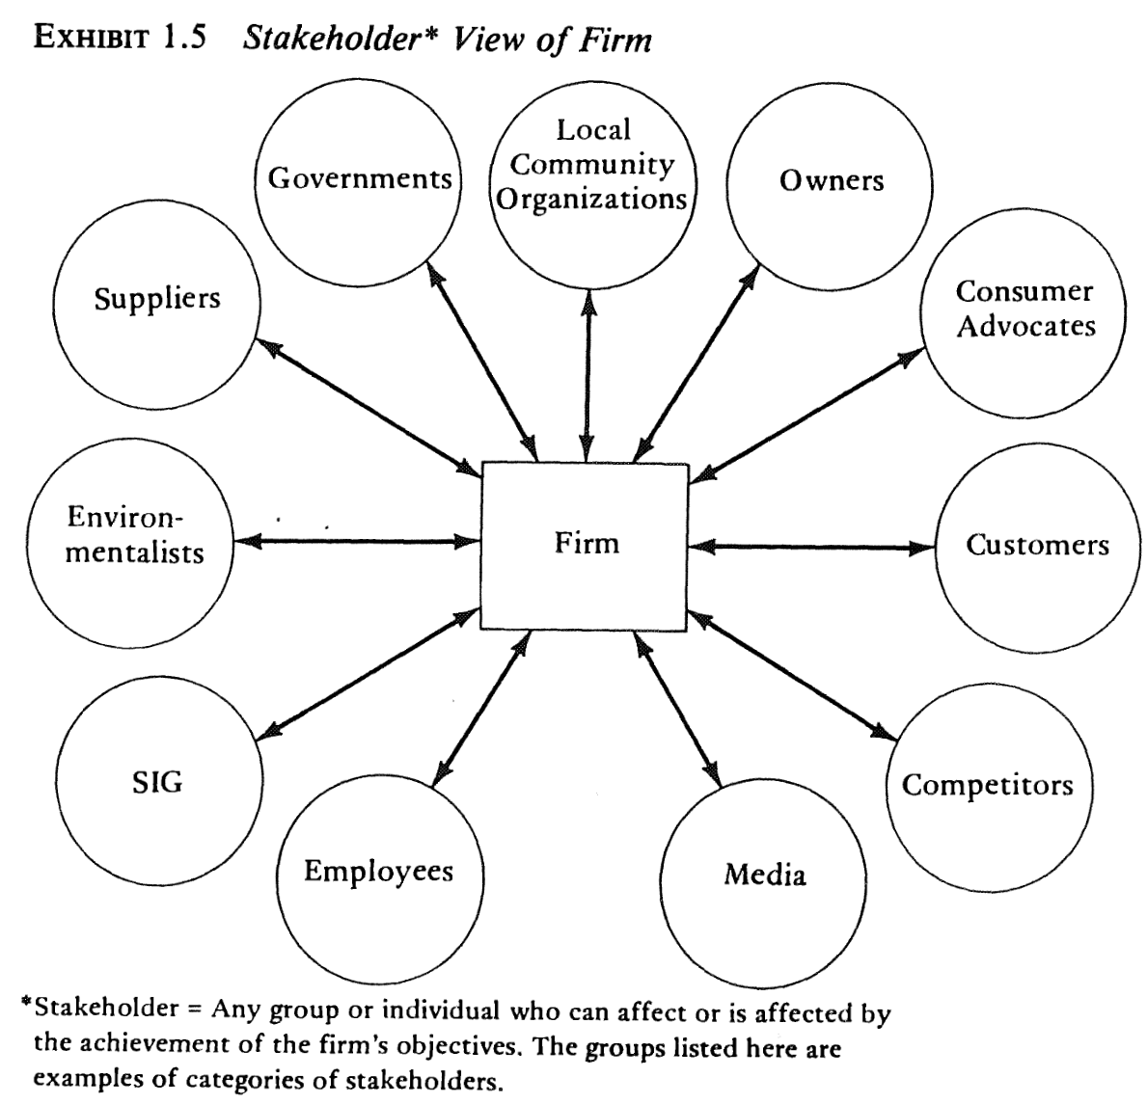
@ Stakeholder Theory
From Freemans’s (1984) “Stakeholder Theory”
Primary stakeholder
Shareowner
Customers
Employees
supplier
Secondary stakeholder

Slide 26
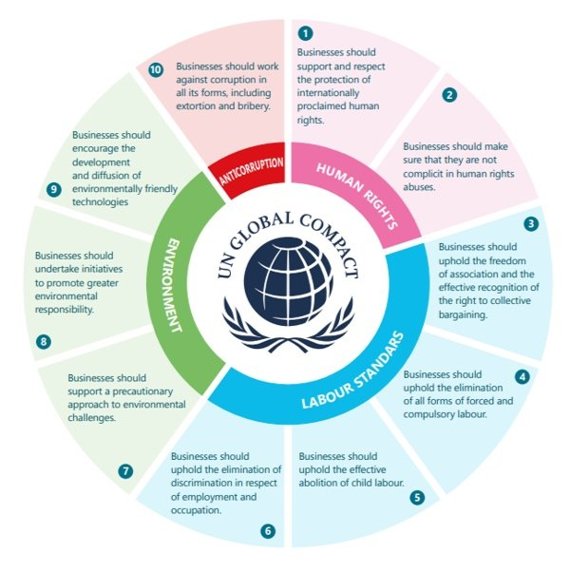
C. Was CSR always there?
2000s - Global Standards:
Frameworks for sustainability reporting
UN Global Compact (2000)
Global Reporting Initiative GRI
Companies integrate CSR into core strategies
Expanded focus:
climate change, diversity, and human rights
2010s-Present - Sustainability & ESG:
Shift to broader Environmental, Social, and Governance (ESG) goals
Increased regulation and mandatory reporting 👉 EU CSRD
Stronger alignment with UN Sustainable Development Goals (SDGs)

Slide 27
C. So ESG is an Updated Version of CSR?
Aspect | ESG | CSR
Purpose | Investor & regulatory-driven: financial risk assessment & sustainability reporting | Ethical and values-driven: company’s moral responsibility to society
Measurement | Quantifiable & standardized: ESG ratings, sustainability reporting frameworks (e.g. GRI). | Qualitative & broader: Company specific CSR priorities, reported in non-standardized sustainability reports
Thematic Focus | Environmental: climate action, carbon footprint Social: diversity, labor rights Governance: board diversity, ethics, compliance | Diverse: Climate action, philanthropy, employee engagement, ethical sourcing, volunteerism & community support
Focus Stakeholders | Investors, regulators & financial markets | Employees, customers & communities
Regulation | Increasingly regulated with mandatory disclosures (e.g., EU CSRD) | Mostly voluntary

Slide 28
So …
👉 give me the tools & we manage it!

Slide 29
Review 1: Reasons so Far to go Beyond Friedman
A. Ethical obligation to do so
B. Secure a „license to operate“
C. Corporate Social Responsibility beyond legal requirements
D. …

Slide 30
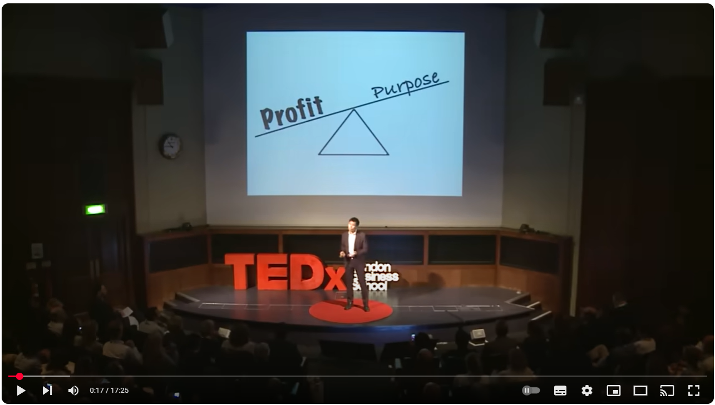
D. …

Slide 31
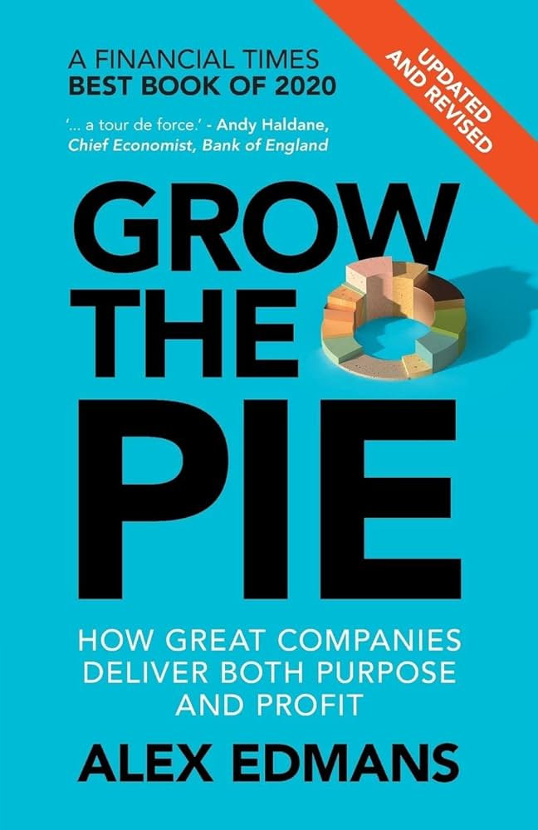
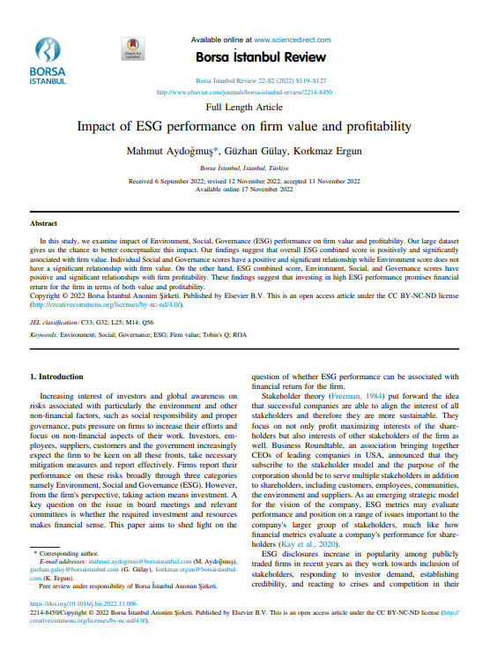
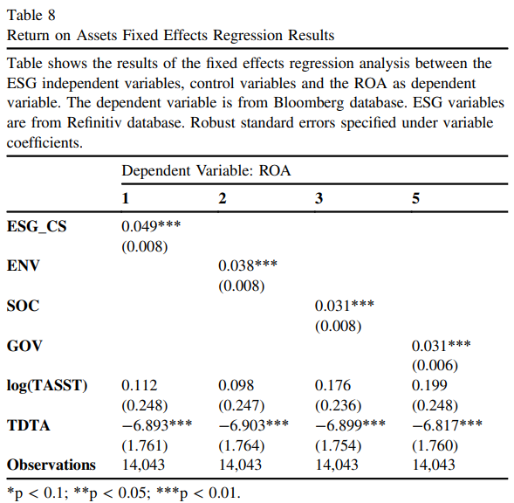
D. CSR Contributes to Company Value & Profit

Slide 32
Review 2: Reasons so Far to go Beyond Friedman
A. Ethical obligation to do so
B. Secure a „license to operate“
C. Corporate Social Responsibility beyond legal requirements
D. CSR contributes to a company’s value & profitability

Slide 33
So …
👉 give me the tools & we manage it!

Slide 34
So …

Slide 35
Let’s Recapitulate: We Manage It!
✅ What?
✅ Why?
👉 Who?
How?

Slide 36
Who should do this?

Slide 37
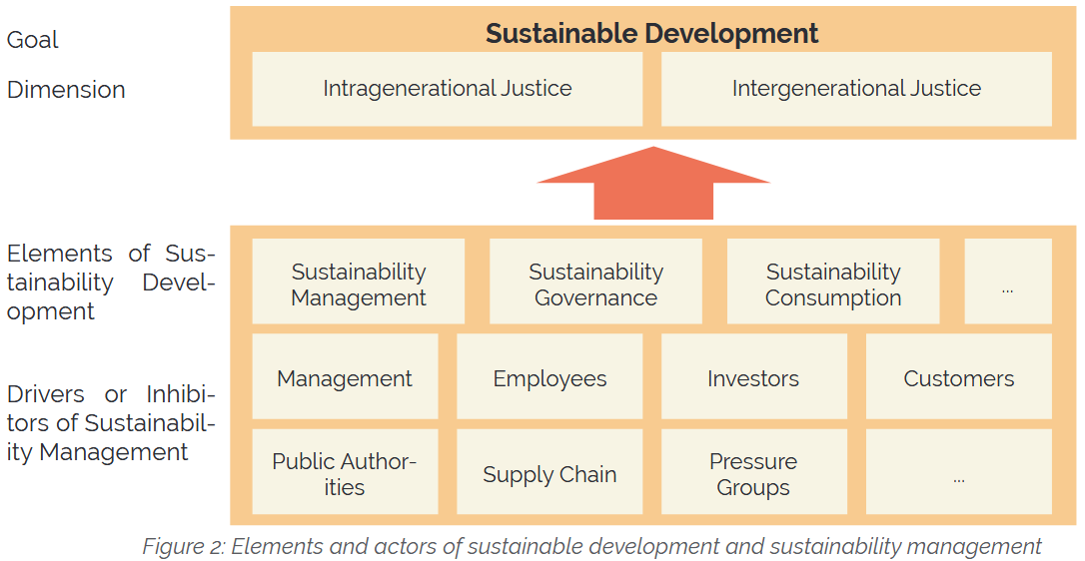
Well: They … as in …

Slide 38
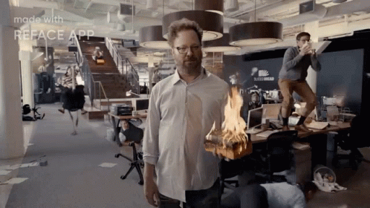
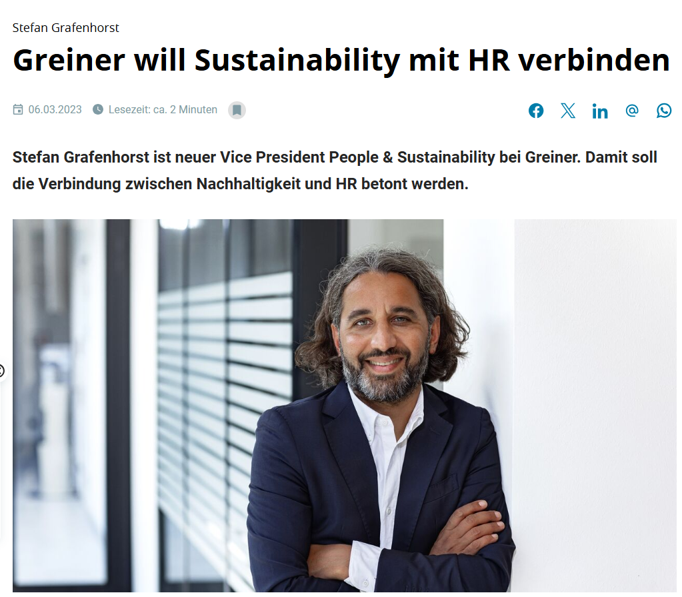
Who the Hell is in Charge of Sustainability & Environmental Management?

Slide 39
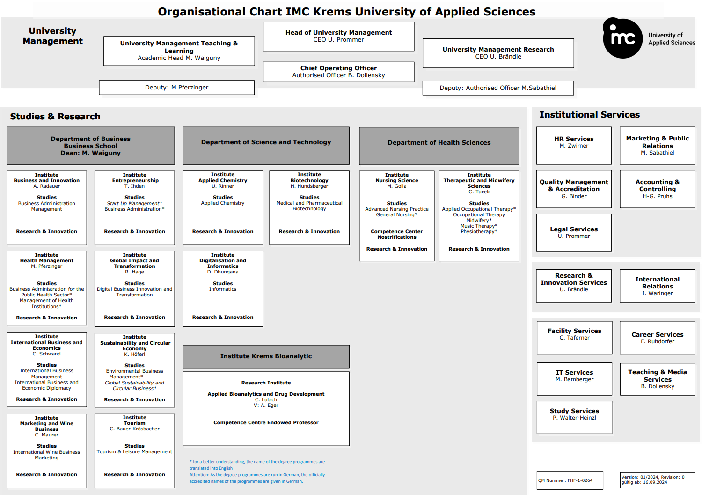
Who the Hell is in Charge of Sustainability & Environmental Management @ IMC?

Slide 40
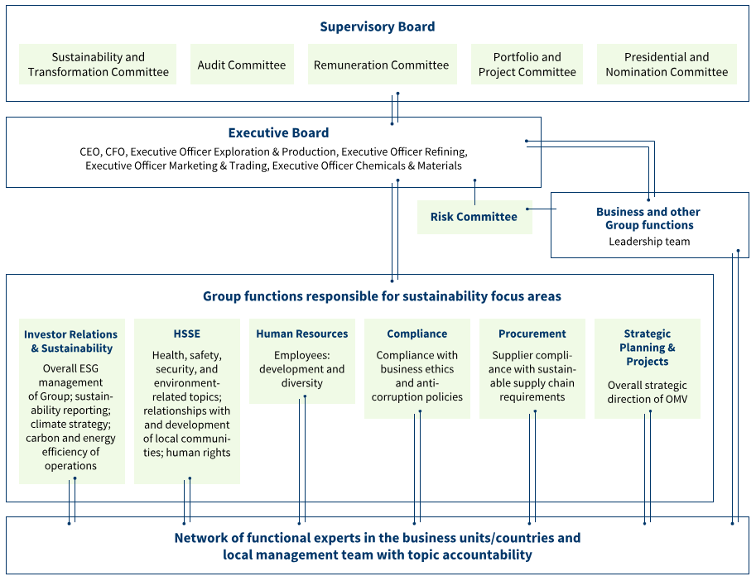
Sustainability Governance @ OMV

Slide 41
Who the Hell is in Charge of Sustainability & Environmental Management @ your Company?
🤔

Slide 42
So: Just Owners, Employees and Consultants then …
In principle: Yes
Develop & implement strategies to
Comply to legal requirements: incl. legally required stakeholder participation
Environmental regulations: Air, water, soil, noise etc.
Sustainability & ESG regulations: EU CSRD
Go beyond these requirements:
Focus environmental performance: EMAS, ISO 14001
Focus CSR: B-Corp, self-defined reports of activities
Focus Stakeholder participation/cooperation: B-Corp, giving profits to trusts, NGOs etc.

Slide 43
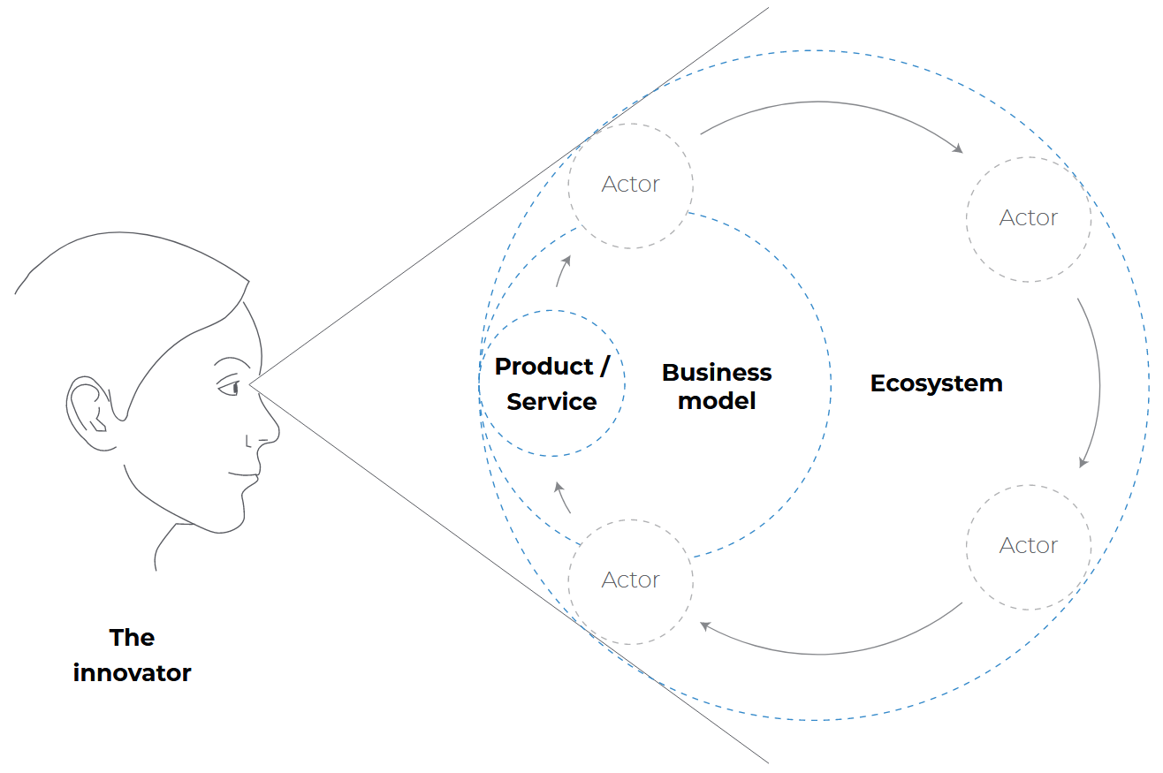
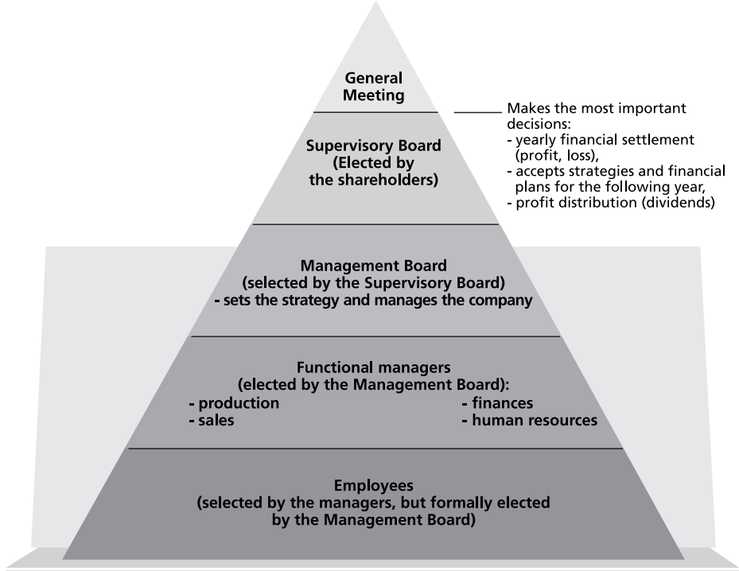

But: Is this Company-Centred Perspective (= Sustainability & Environmental Management) enough?

Slide 44
What Could Possibly go Wrong?
🤔

Slide 45
What Could Possibly go Wrong?
Market failure:
= when free markets allocate resources inefficiently or inequitably:
Environmental costs are not reflected in market prices
Monopolies or oligopolies distort pricing and access
Outcomes do not maximise overall societal welfare
👉 public intervention to correct harmful economic & environmental effects

Slide 46










Typical Market Failures & Limitations of Atomistic Actors
Negative externalities: Companies pollute without bearing the full cost 👉 harming society & ecosystems
Public goods overuse: Resources like clean air or oceans are overexploited without regulation 👉 tragedy of the commons
Imperfect or asymmetric information: Firms may withhold environmental data, limiting informed decision-making
Short-term market logic: Markets often prioritise short-term profits
Inadequate voluntary action: Corporate initiatives = often insufficient to address systemic environmental issues
Company XY

Slide 47
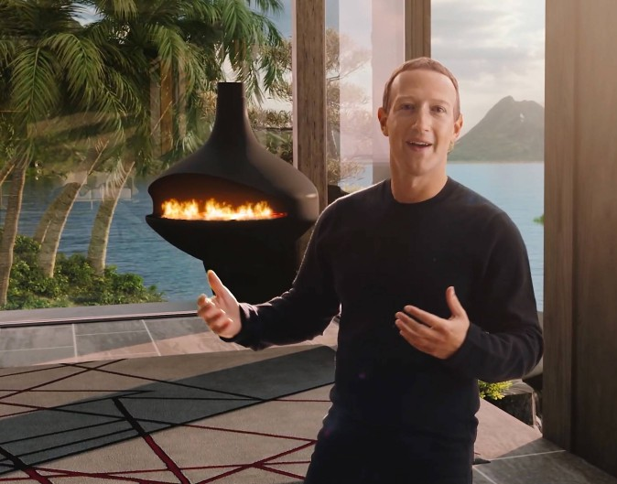
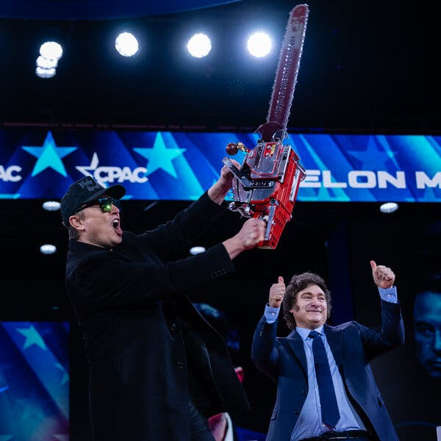
Ideal Characteristics of Governments & Public Entities
Market failures: often longtime effects 👉 Enable long-term commitment of (public) funds
Ability for long-term planning & implementation
Provide Rule of law
Predictability
Actionability
Orientation towards socio-political requirements:
"Common good"
Principle of equal treatment

Slide 48
To Avoid these Market Failures: Sustainability & Environmental Governance
👉 broader coordination of multiple actors
governments, companies, civil society, NGOs & international institutions
Aim: steering society (not just companies) toward sustainable development
Tools: Laws, policies, international agreements & multi-actor initiatives 👉 shaping the regulatory and normative framework
Addressing: Systemic, cross-border challenges that single actors cannot solve alone
Climate change, biodiversity loss, etc.
Focus: Accountability, legitimacy & participation in decision-making

Slide 49
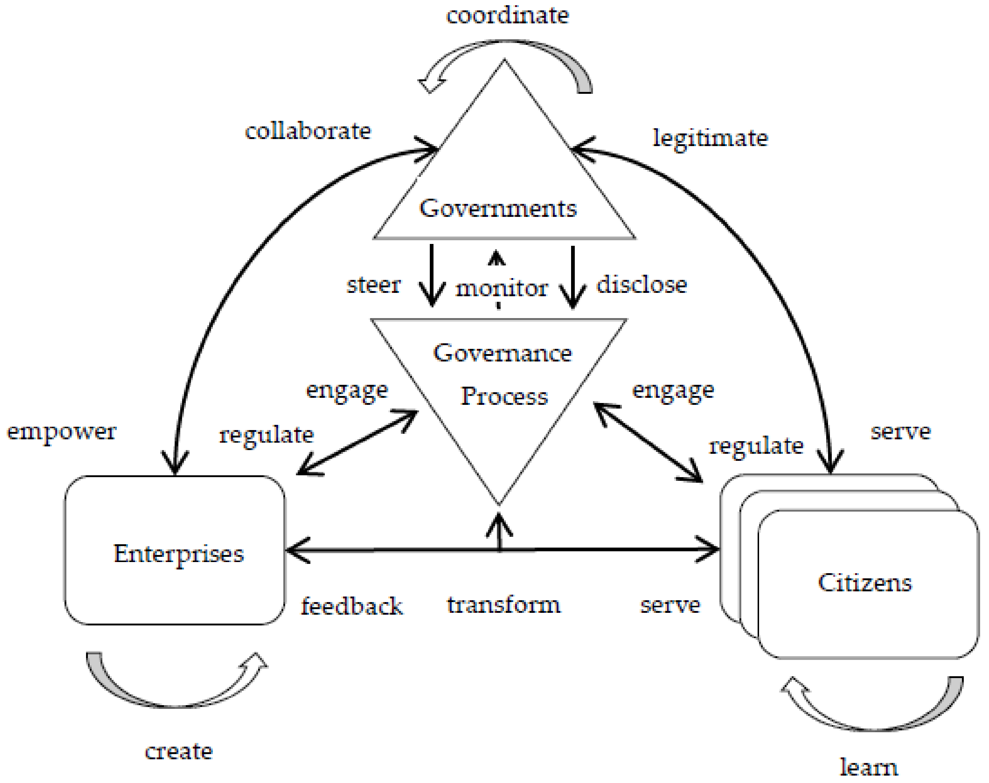
To Avoid these Market Failures: Sustainability & Environmental Governance

Slide 50
S&E Management vs. Governance
Aspect | Sustainability Management | Sustainability Governance
Main Actors | Companies, business managers | Governments, NGOs, international bodies, networks
Scope of Action | Organisational, intra-firm | Societal, systemic
Focus | Strategy, operations, stakeholder dialogue | Policy-making, institutional frameworks
Goal | Integrate sustainability into business | Coordinate multi-level action for sustainable development
Key Tools | Reporting, auditing, CSR, ESG | Laws, treaties, frameworks, public policy

Slide 51
I get it …
👉 give me the tools & we manage it!

Slide 52
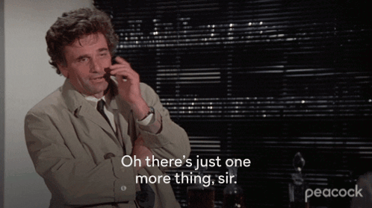
Noooo …

Slide 53
Who are Governments & Public Entities?
🤔

Slide 54
Public Entities & where to find them

Slide 55
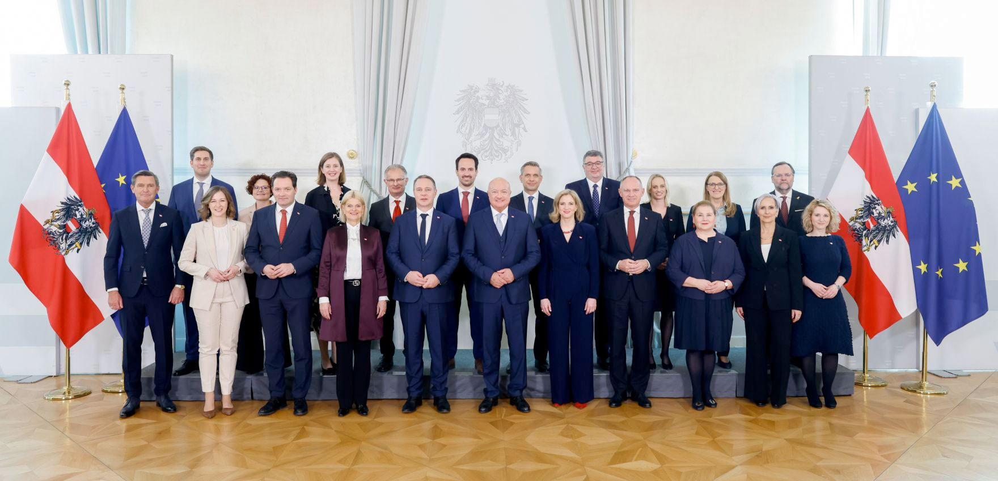
Well … Quite Easy ✅

Slide 56
Who the Hell is in Charge of S&E Governance in AUT?
🤔

Slide 57
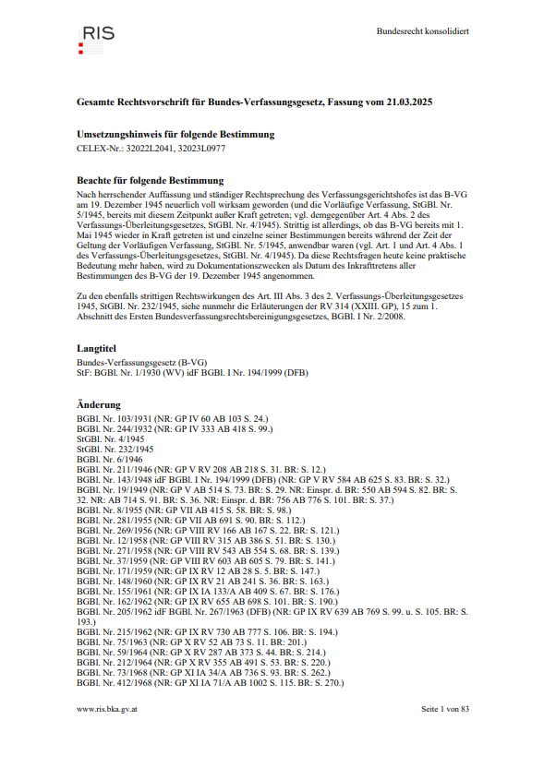
Who the Hell is in Charge of S&E Governance in AUT?
Zusätzlich zu Artikeln 10, 11 & 12:
„Artikel 15. (1) Soweit eine Angelegenheit nicht ausdrücklich durch die Bundesverfassung der Gesetzgebung oder auch der Vollziehung des Bundes übertragen ist, verbleibt sie im selbständigen Wirkungsbereich der Länder.”
[…]
“Artikel 18. (1) Die gesamte staatliche Verwaltung darf nur auf Grund der Gesetze ausgeübt werden.”

Slide 58
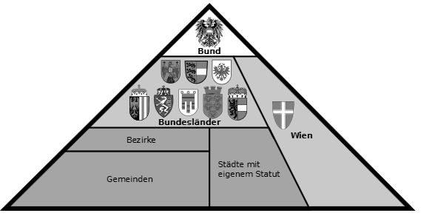
Digression: How to Manage a State
Regions

Slide 59
Who the Hell is in Charge of S&E Governance in AUT?
Themenbereich | Gesetzgebung bzw. Leitlinien | (Planungs-)Träger bzw. Behörden
Siedlungs-entwicklung* | Landesregierung | Raumplanungsabteilungen Länder Gemeinden
Siedlungswasserbau | BMLRT (BMDW) | Gemeindeverwaltung (Gemeinde-)Verbände
Abfallentsorgung (nicht-gefährliche Abfälle) | Landesregierung (BMK) | Gemeindeverwaltung (Gemeinde-)Verbände
Abfallentsorgung (gefährliche Abfälle) | BMLRT | Sektion (VI) BMLRT
Forstwirtschaft | BMLRT | Bezirksforstbehörden (BH) (Bundesforste)
Landwirtschaft | BMLRT (Landesregierung) | Agrarbezirksbehörden (Landesverwaltung/regional) (Landesregierung)

Slide 60
Who the Hell is in Charge of S&E Governance in AUT?
Themenbereich | Gesetzgebung bzw. Leitlinien | (Planungs-)Träger bzw. Behörden
Flüsse | BMLRT (BMK) | Bundeswasserbauverwaltung (Landesregierung) Via Donau (div. Standorte)
Wildbäche & Lawinen* | BMLRT | Forsttechnischer Dienst für Wildbach- & Lawinenverbauung (Sektionen & Gebietsbauleitungen)
Betriebsanlagen | BMDW | Gewerbebehörde (BH)
Verkehr – national (Straße & Schiene) | BMK | ASFINAG (div. Standorte) ÖBB (div. Standorte)
Verkehr – Länder | Landesregierung | Abteilungen Straßenbau & -erhaltung (Landesverwaltung)
Verkehr – Gemeinden | Landesregierung BMK | (Abteilung in) Kommunalverwaltung
Tourismus | (Landesregierung) | Wirtschaftskammer (nat. & reg.) Verbände & Vereine

Slide 61
Well … Quite Easy ✅
Peter Hanke: Bundesminister für Klimaschutz, Umwelt, Energie, Mobilität, Innovation und Technologie
Norbert Totschnig: Bundesminister für Land- und Forstwirtschaft, Regionen und Wasserwirtschaft
Notes:
*

Slide 62
Multi Level S&E Governance in AUT
Regions
Company XY

Slide 63
Multi Level S&E Governance in AUT
Sustaina-bility Report
Environmental Impact Assessment
Regions
Building permit, land use zoning
Operating Permit, water rights notice
Company XY

Slide 64
Even more Multi-Level S&E Governance 1
European Union
Regions

Slide 65
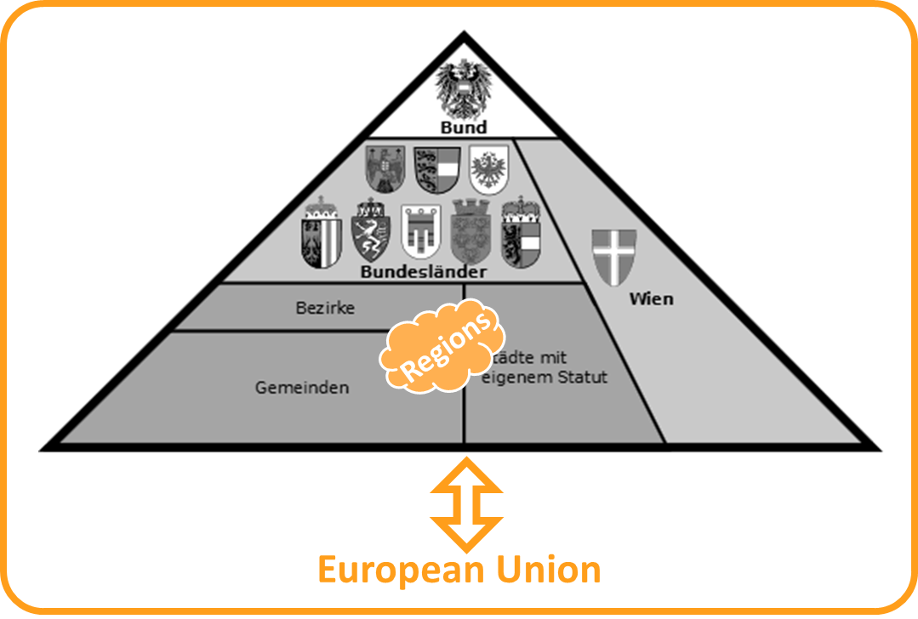
Even more Multi-Level S&E Governance 1
EU Legislation:
Regulation: Binding in full & directly applicable in all EU countries
EU Taxonomy Regulation
Directive: Binding in result 👉 member states decide on how 2 implement
EU Directive on corporate sustainability reporting (CSRD)

Slide 66
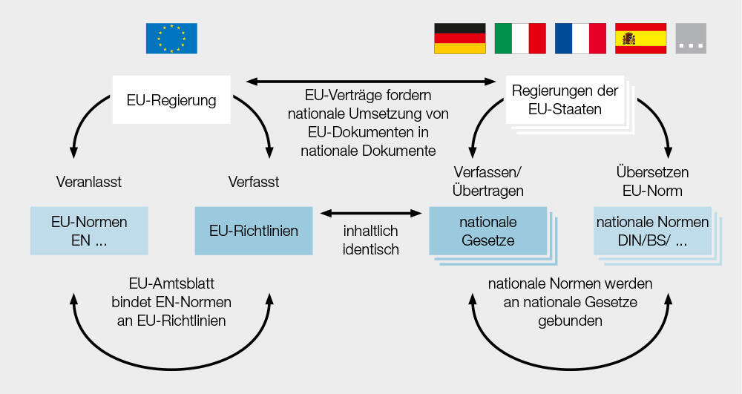
Even more Multi-Level S&E Governance 1: EU Legislation

Slide 67
Even more Multi-Level S&E Governance 1
EU Legislation:
Regulation: Binding in full & directly applicable in all EU countries
EU Taxonomy Regulation
Directive: Binding in result 👉 member states decide on how 2 implement
EU Directive on corporate sustainability reporting (CSRD)
Decision: Binding only on those to whom it is addressed (member state or company)
EU Decision on CO₂ emissions from car manufacturers
Recommendation: Non-binding guidance to encourage aligned actions
Opinion: Non-binding expression of views from an EU institution

Slide 68
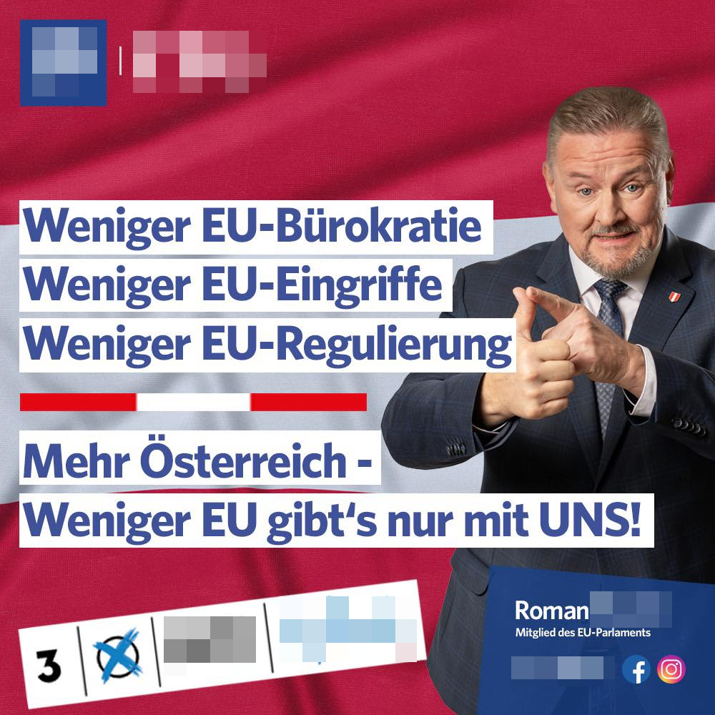
Even more Multi-Level S&E Governance 1:Why?
Cost savings through compliance
Facilitation of trade & investment
Enhanced environmental protection 👉 coherence
Promotion of green growth & climate neutrality goals

Slide 69
Even more Multi-Level S&E Governance 2
Other supranational organisations: United Nations, Council of Europe, etc.
European Union
Regions

Slide 70
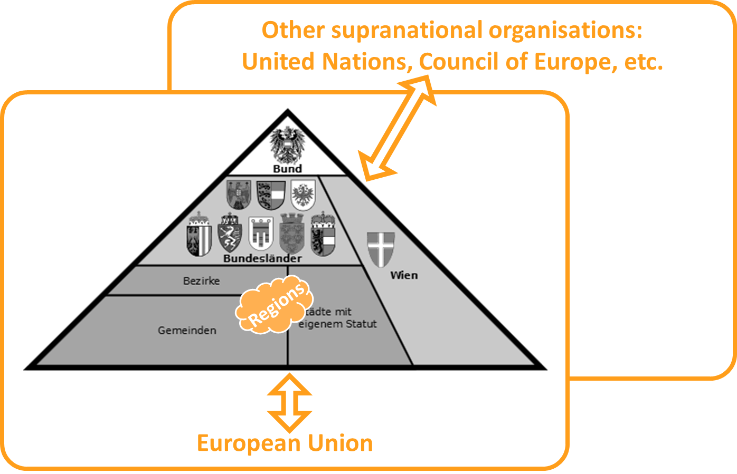
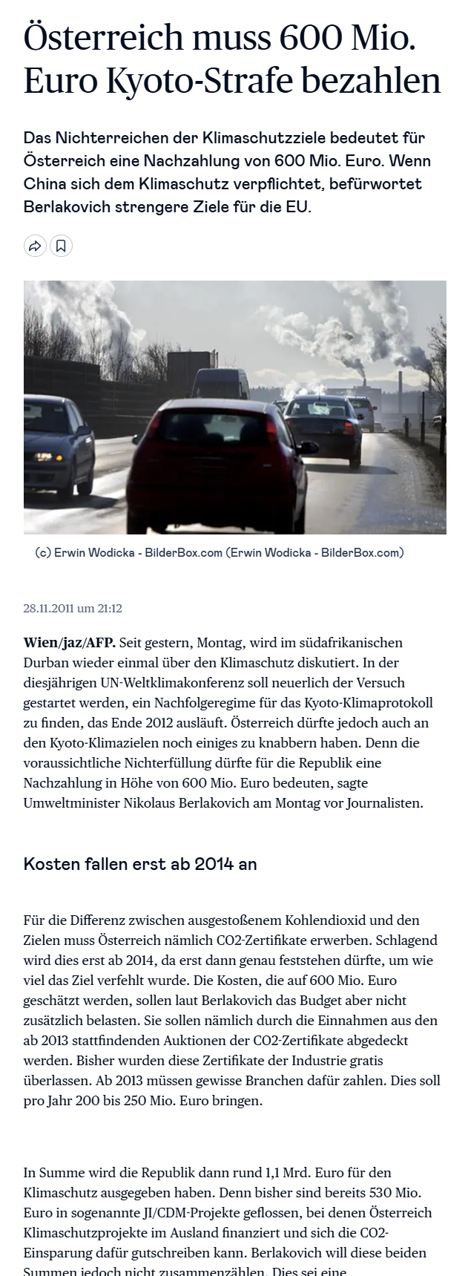
Even more Multi-Level S&E Governance 1
UN Conventions:
1985: Vienna Convention for the Protection of the Ozone Layer
1992: United Nations Framework Convention on Climate Change (UNFCCC)
1998: Kyoto Protocol
2015: Paris Agreement & 2030 Agenda (👉 SDGs)

Slide 71
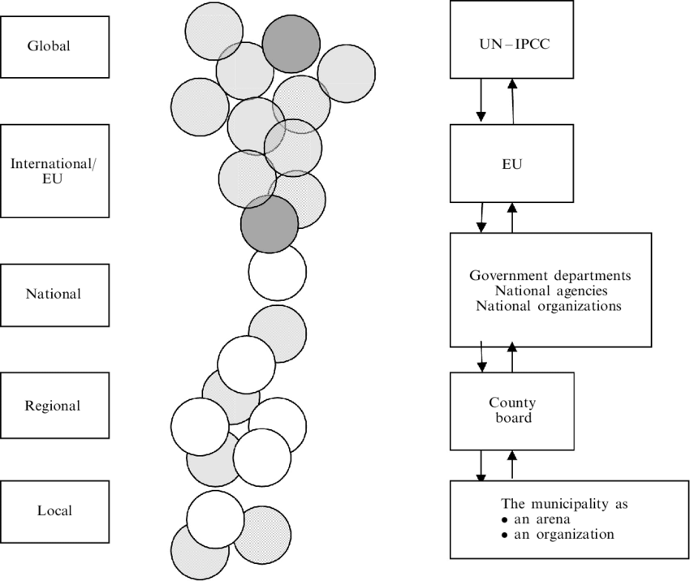
Multi-Level S&E Governance works Both Ways

Slide 72
Let’s Recapitulate: We Manage It!
✅ What?
✅ Why?
✅ Who?
👉 How?

Slide 73
Outlook

Slide 74
Wrap it up

Slide 75
Till next Session:

Slide 76
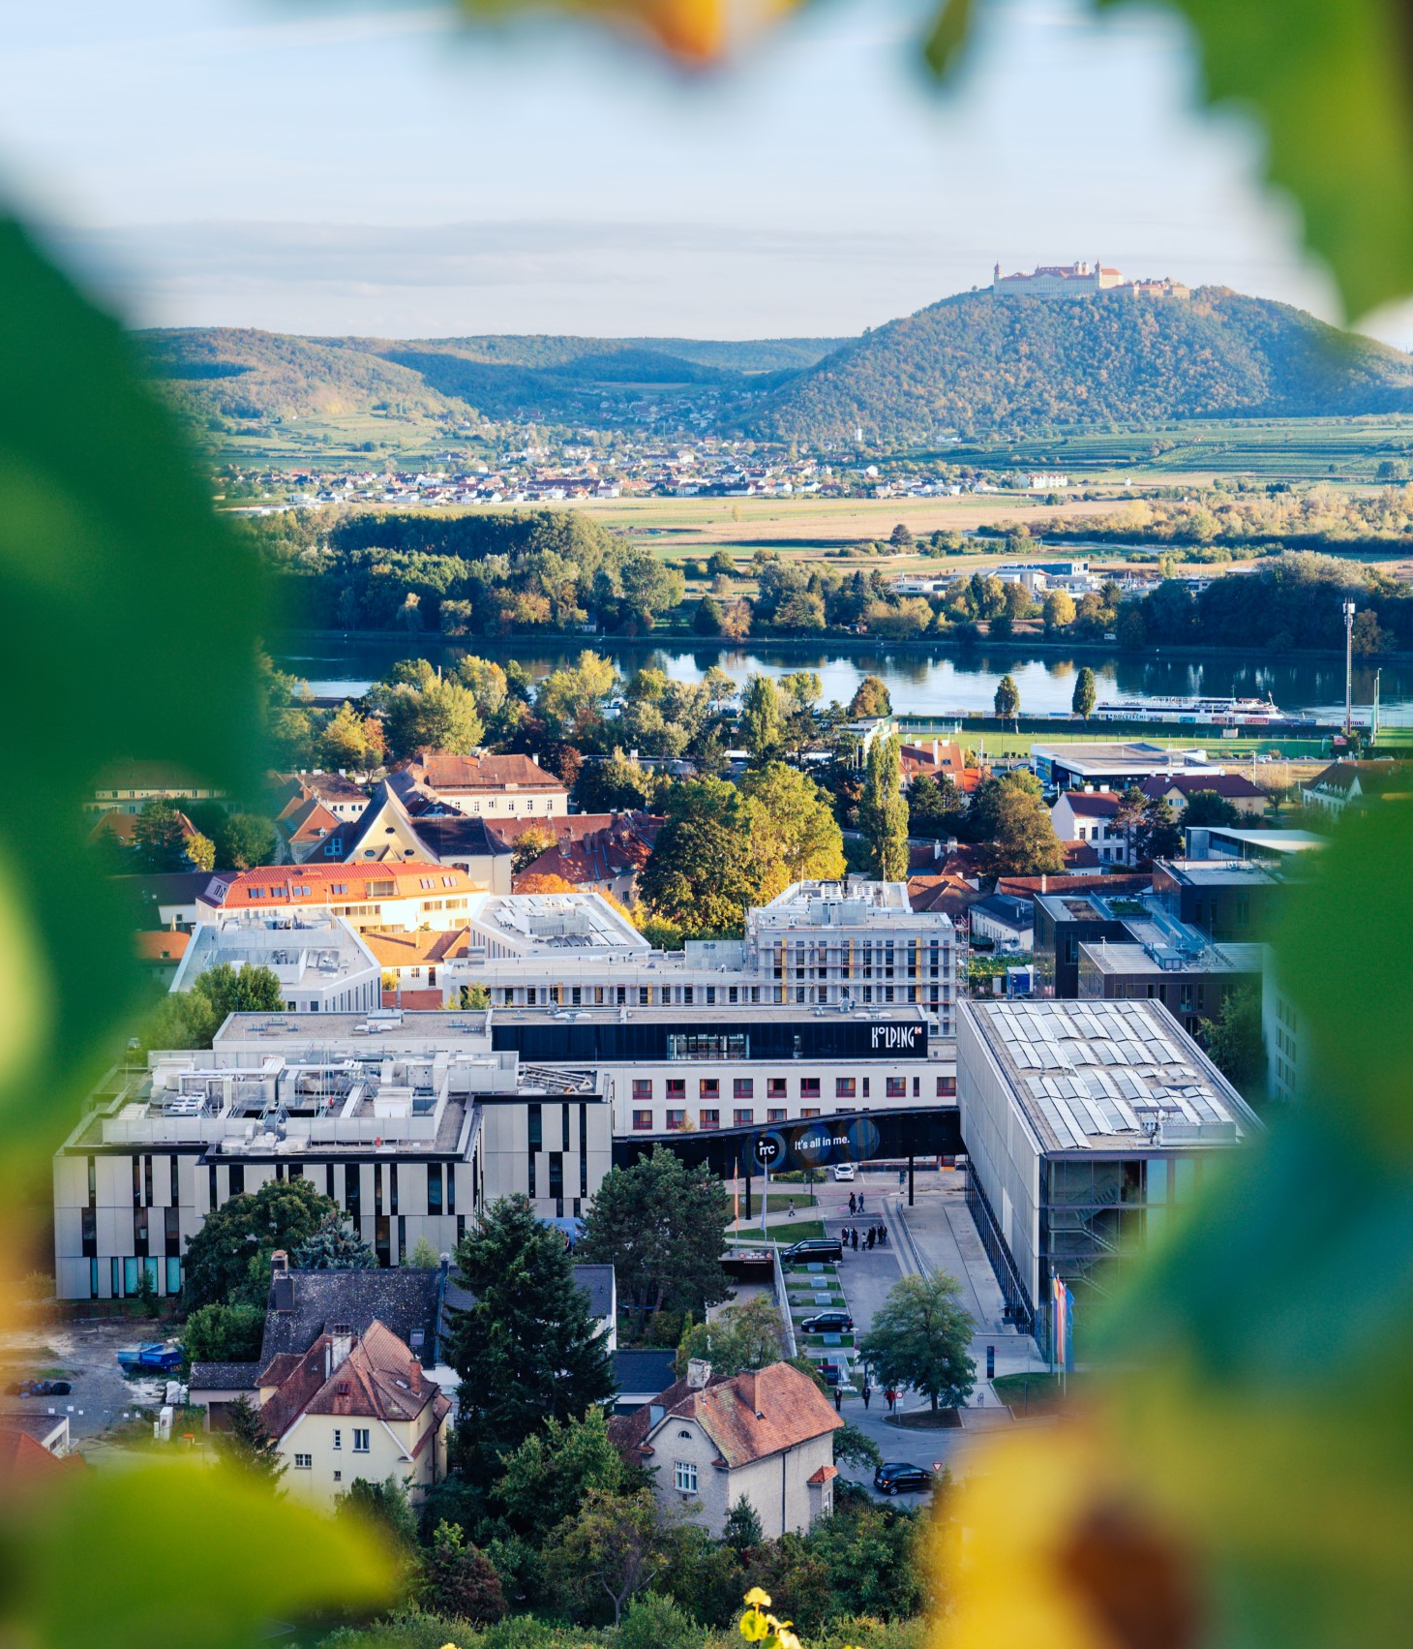

So long & cheerio!

